Slide 1
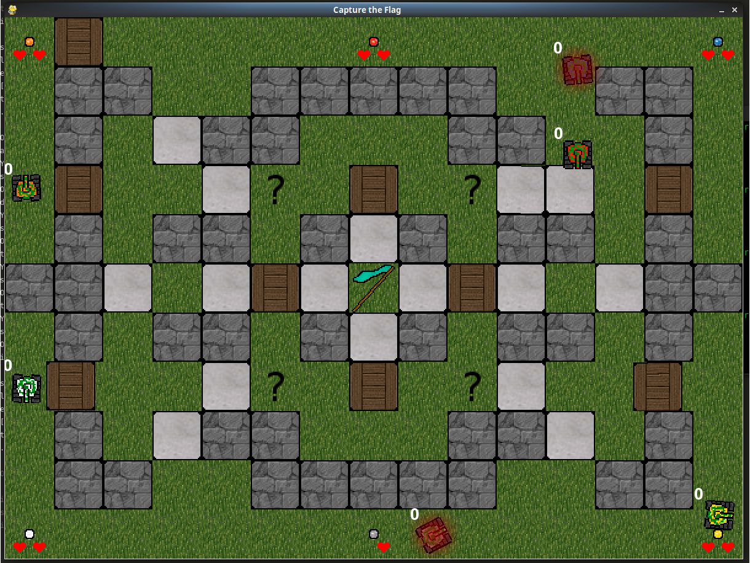
Capture the flag
Adam Andersson
Aleksi Evansson
Ludvig Westerdahl

Slide 2
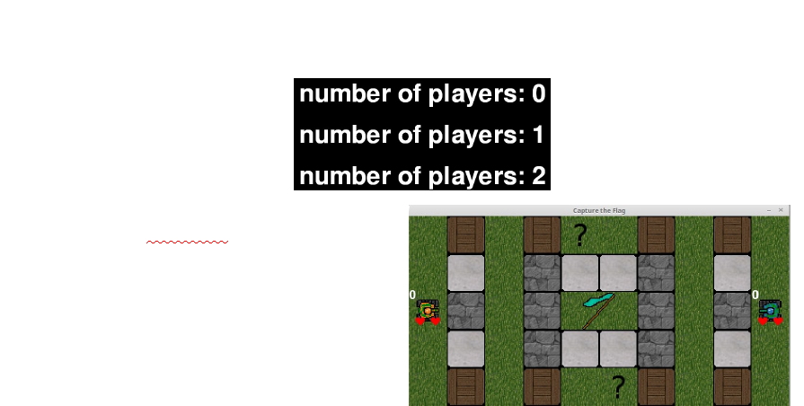

Slide 3
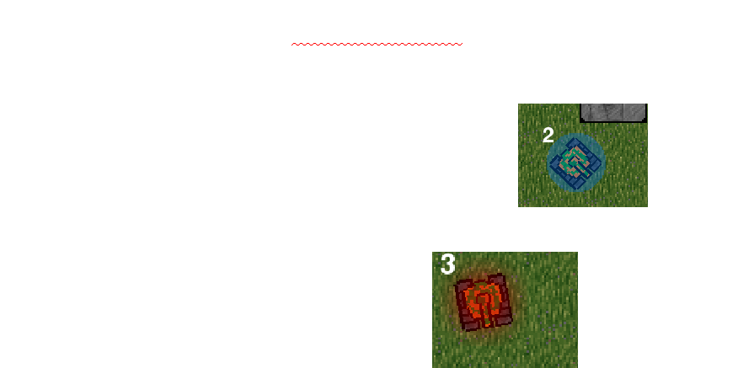

Slide 4

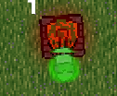
Powerups and Powerdowns
Increased speed
Increased damage
Sticky ammunition
Shield
Reduced speed
Extreme overheat

Slide 5
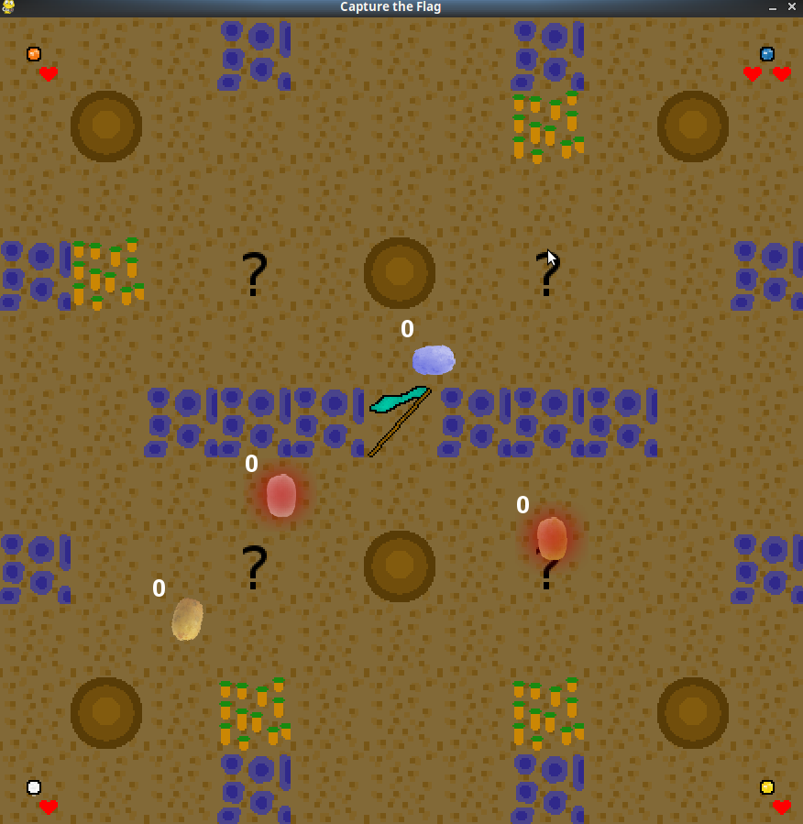
The Future
Upcoming patch
Free DLC
Potato pack

